Slide 1
The gamma beta phi national honor society
<School name>

Slide 2
The gamma beta phi society

Slide 3
History of gamma beta phi
Chartered on March 22, 1964 in Spartanburg, South Carolina
Created as a collegiate extension of the Beta Club, a high school honors society founded by Dr. John W. Harris

Slide 4
Creation of today’s national Objectives for gamma beta phi
To recognize and encourage in education
To promote the development of leadership ability and character in its members
To foster, disseminate, and improve education through appropriate service projects

Slide 5
Gamma beta phi today
The Society serves as one of the nation’s premiere “general” honor societies
Holds over 80 chapters at community colleges, liberal arts institutions, private colleges, and public research universities across America
The Society has inducted well over 100,000 collegiate scholars since its inception

Slide 6
The gamma beta phi difference
Magic Number: 272
The number of collegiate honor societies across America
They vary in functionality, based on student eligibility and the type of institution
The vast majority of collegiate honor societies focus on what you have done, pre-induction
The Gamma Beta Phi Society focuses on what you will do post-induction
Gamma Beta Phi is a national/collegiate honor AND service society
Focus on identifying the best and the brightest collegiate scholars across America, and challenging them to impact their local communities through philanthropy and service projects

Slide 7
Pillars of gamma beta phi
Scholarship
Service
Character

Slide 8
Pillar #1 – scholarship
Members excel inside of the classroom, earning high remarks from their professors and peers alike
They succeed in all areas of academia, with academic disciplines that span the spectrum between undergraduate and graduate studies

Slide 9
Pillar #2 – service
Philanthropy serves as the core of our Society
Our chapters implement a myriad of service projects each year, both big and small, to empower those around them
With thousands of collegiate scholars across America focusing on philanthropic work annually, Gamma Beta Phi is truly leading the way in terms of social change and community development

Slide 10
Pillar #3 – character
The Society empowers members to look inside of themselves and ignite the change agent within
Identify ways that you can use your own achievements to change someone’s life!
Members become empowered leaders, both on their campus and within their local community
Each year, we induct thousands of scholars, who go on to graduate with the tools to literally change the world!

Slide 11
7 Benefits of joining the gamma beta phi society
National Recognition
Affordability
Inclusive Eligibility/Diversity

Slide 12
7 Benefits of joining the gamma beta phi society
National
Leadership Development Opportunities
LeAnne Salazar
New Mexico State University
Carson Reed
University of South Carolina, Beaufort
Justice Peyton
University of North Carolina, Chapel Hill
Notes:
You can join the Gamma Beta Phi Society and make a difference in your community as a member, but if you have a desire to learn more about leadership, there are multiple ways you can serve. First, you can serve in a leadership position within your own chapter [insert info here about how your chapter functions, if there are special functions/events that you hold, etc.]. If you are interested in not only serving as a member in your chapter but also serving other units in your geographic area, consider serving as a Region Senator, where you would interact with chapters across several states. There are even national opportunities, as GBP National Senate has student members who participate in the policy and decision making that impacts the entire Society.

Slide 13
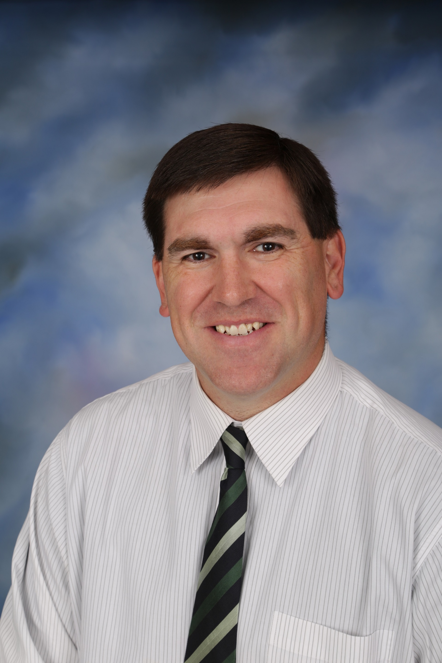
7 Benefits of joining the gamma beta phi society
Alexis Minor Southeastern Louisiana University
Alex Sykes
Virginia Tech
Scholarships
Emily McCabe Mississippi State University
Jason Arledge University of Mississippi
Notes:
Scholarships open in spring semester each year. Check the GBP website for more details as the time draws nearer.

Slide 14
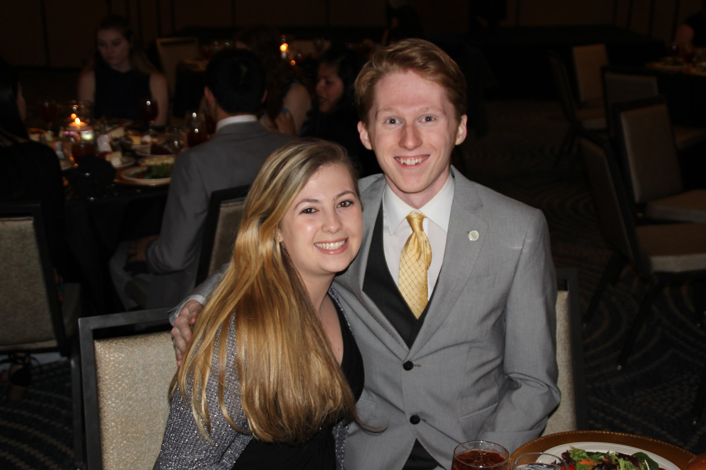
7 Benefits of joining the gamma beta phi society
Networking Opportunities
Notes:
You may have opportunities to network within your campus community, at region events, and even at national events.

Slide 15
7 Benefits of joining the gamma beta phi society
Leave a Lasting
Impact on Your Community
Notes:
Our local chapter is active in the community in these ways…

Slide 16
National service projects
Each year, the Society identifies a major service project for Chapters to emphasize during the academic year
Previous “National Projects” have included efforts for The Little Free Library, Wounded Warriors Foundation, St. Jude Children’s Hospital, and Heifer International

Slide 17
Gamma beta phi memorabilia
Notes:
As the time comes for you to graduate, you should be proud of your accomplishments, so be sure to wear your honor cord and honor stole as you walk across that stage!

Slide 18
How was I selected as an eligible member?
Enrolled at <insert school name>
Hold a cumulative GPA of at least a 3.0 (on a 4.0 scale)
Hold at least 12 credit hours
Notes:
[These are the national minimum requirements; each chapter has the ability to have even more strict requirements, so be sure to adapt this slide to represent your specific chapter requirements.]

Slide 19
How can I join? When is the Deadline to join?
ARE YOU GAMMA BETA
PHINE
ENOUGH?
Visit the Gamma Beta Phi Society National Website, click on “<insert school name>” (via the “Accept Membership” page) and join!
Deadline: <insert date>!
Complete the membership submission form and pay the one-time national fee of $70, plus the local chapter fee of $15.
Refer Questions To:
National Headquarters: April McMillan – info@gammabetaphi.org
Notes:
[Insert your chapter details]

Slide 20
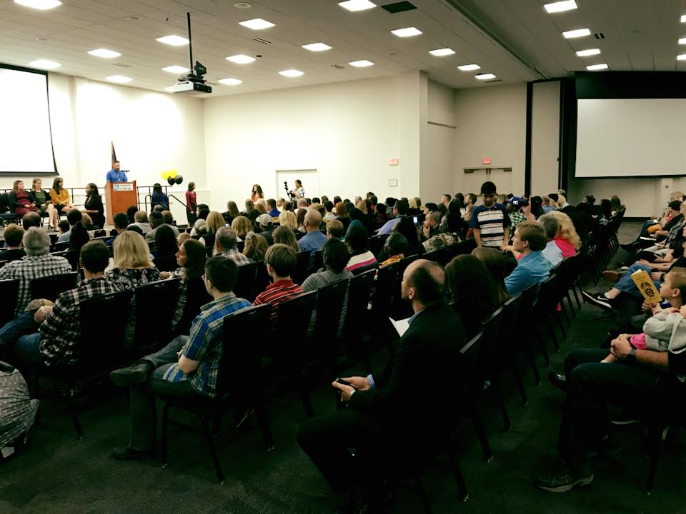
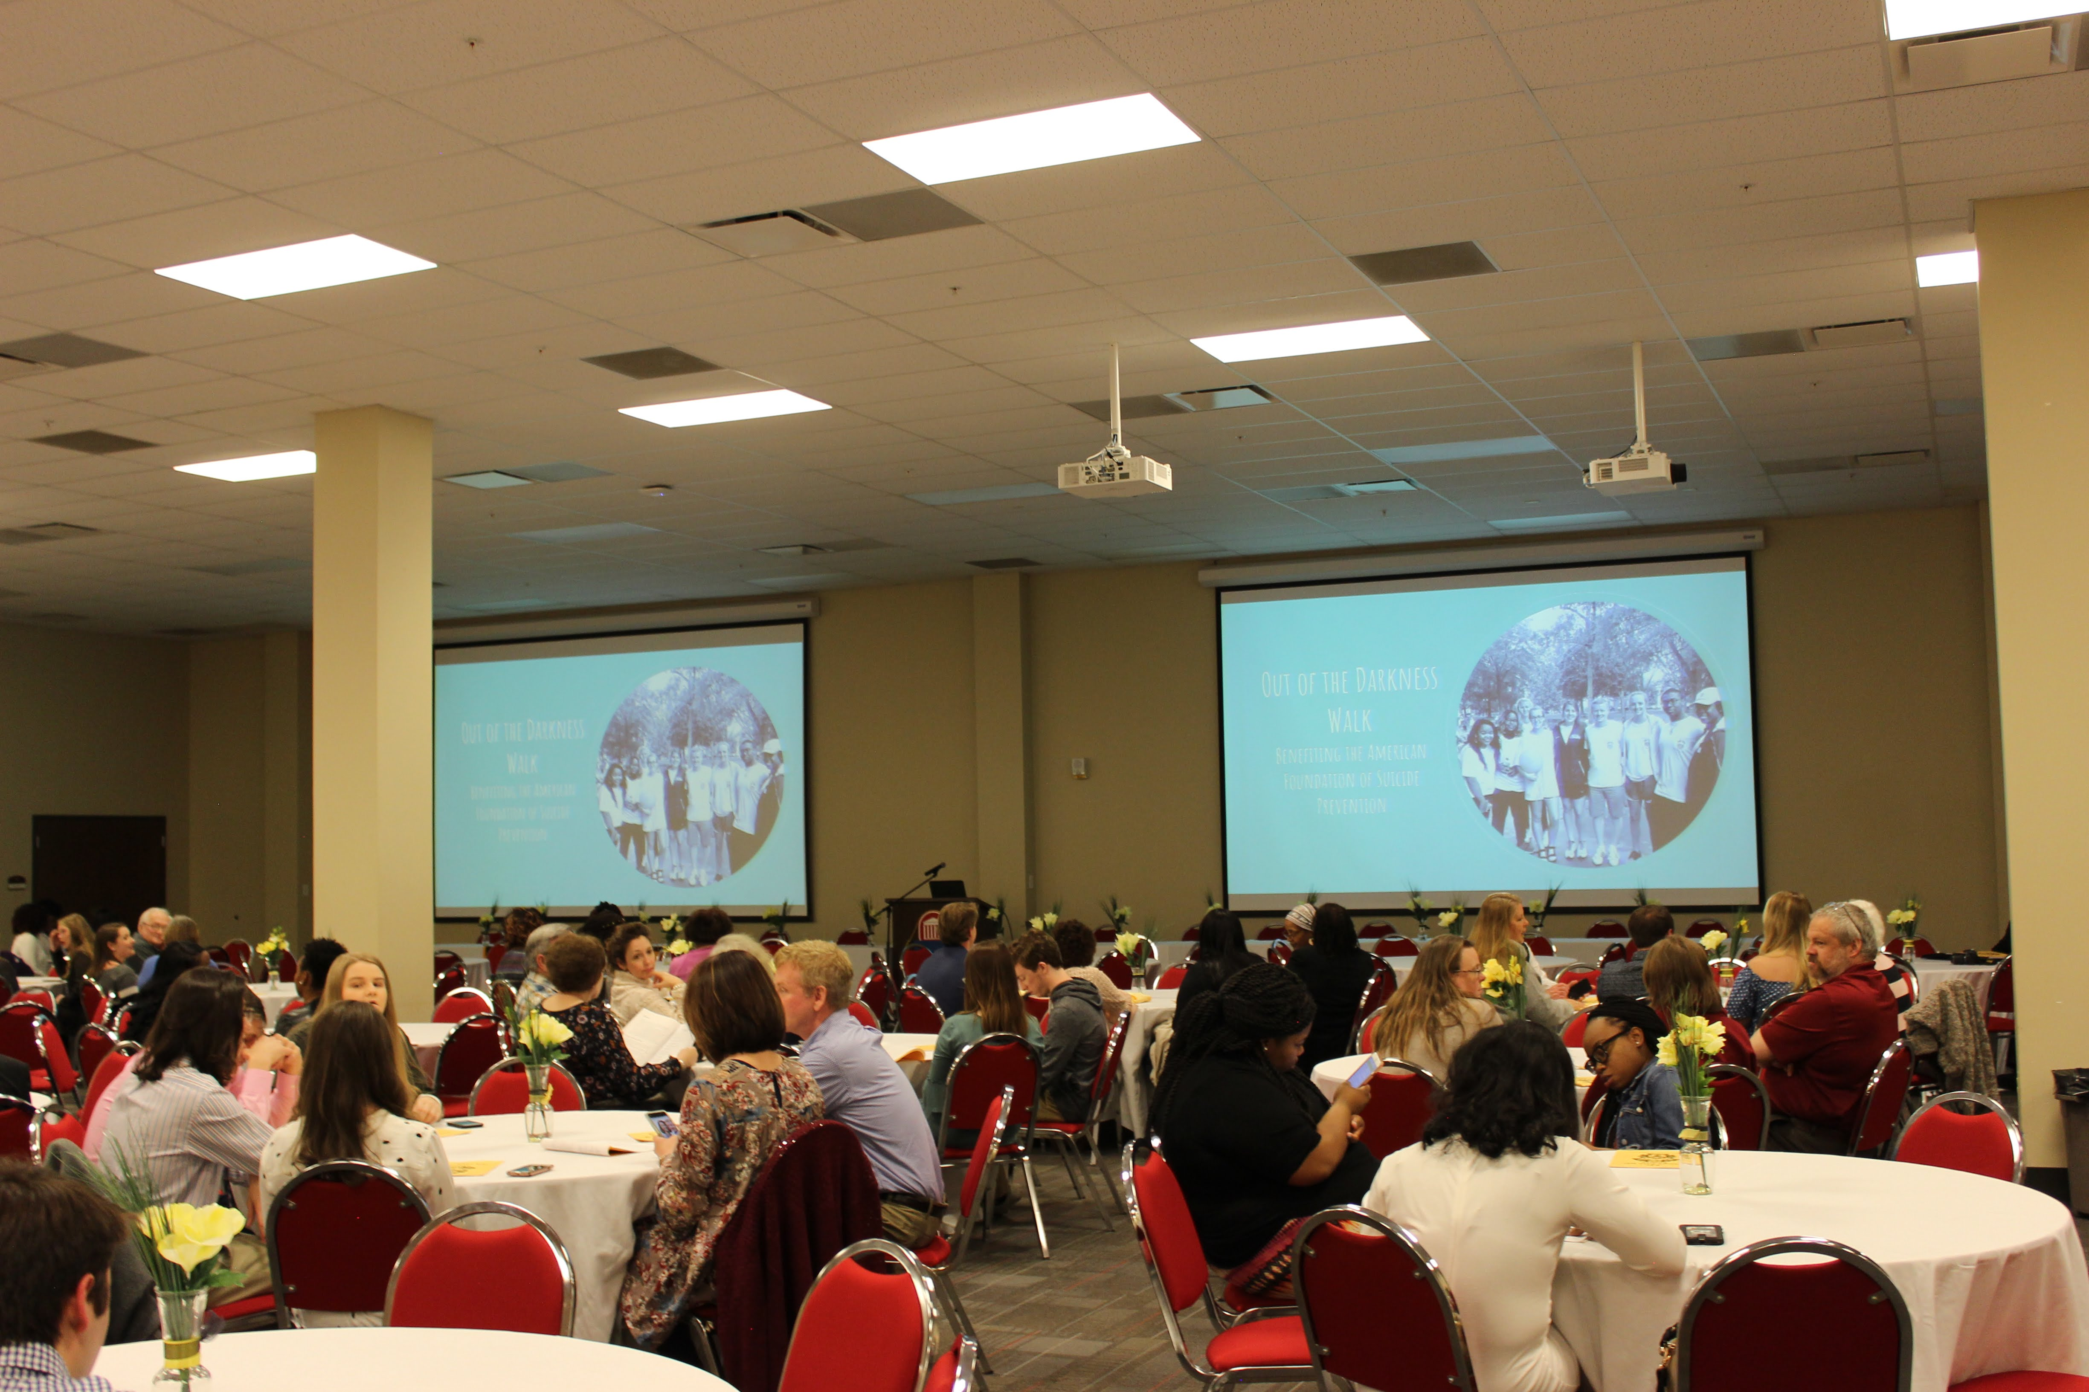
Induction ceremony
A time to celebrate both your academic achievement and your decision to give back to your community through philanthropy!
Invite family members, friends, peers, faculty/staff and more!
Notes:
[Provide the date/time/location of the Induction Ceremony (some schools hold an Induction each semester, while some only hold spring Inductions even if they recruit new members in both semesters).]

Slide 21
As a member, how can I get involved?
Engage with your chapter regularly, either as a contributing member or an Executive Board member (President, Vice President, Secretary, Treasurer, etc.)
Identify ways to use your scholarship, intellect, and passion to impact both your campus and your local community

Slide 22
Remember…
“Service is the rent we pay to be living. It is the very purpose of life and not something you do in your spare time.”
Marian Wright Edelman

Slide 23
Questions?

